Slide 1
IMPORTANT DISCLOSURE INFORMATION
Past performance may not be indicative of future results. Different types of investments involve varying degrees of risk. Therefore, it should not be assumed that future performance of any specific investment or investment strategy (including the investments and/or investment strategies recommended and/or undertaken by The Foster Group (“Foster Group”), or any non-investment related content, will be profitable, equal any corresponding indicated historical performance level(s), be suitable for your portfolio or individual situation, or prove successful. Foster Group is neither a law firm, nor a certified public accounting firm, and no portion of its services should be construed as legal or accounting advice. Moreover, you should not assume that any discussion or information contained in this presentation serves as the receipt of, or as a substitute for, personalized investment advice from Foster Group. Please remember that it remains your responsibility to advise Foster Group, in writing, if there are any changes in your personal/financial situation or investment objectives for the purpose of reviewing/evaluating/revising our previous recommendations and/or services, or if you would like to impose, add, or to modify any reasonable restrictions to our investment advisory services. A copy of our current written disclosure Brochure discussing our advisory services and fees is available upon request. The scope of the services to be provided depends upon the needs of the client and the terms of the engagement.
Historical performance results for investment indices, benchmarks, and/or categories have been provided for general informational/comparison purposes only, and generally do not reflect the deduction of transaction and/or custodial charges, the deduction of an investment management fee, nor the impact of taxes, the incurrence of which would have the effect of decreasing historical performance results. It should not be assumed that your Foster Group account holdings correspond directly to any comparative indices or categories. Please Also Note: (1) performance results do not reflect the impact of taxes; (2) comparative benchmarks/indices may be more or less volatile than your Foster Group accounts; and, (3) a description of each comparative benchmark/index is available upon request.

Slide 2
What’s Up (or Down) With the Bonds?
June 10, 2024
Kent Kramer, Chief Investment Officer

Slide 3
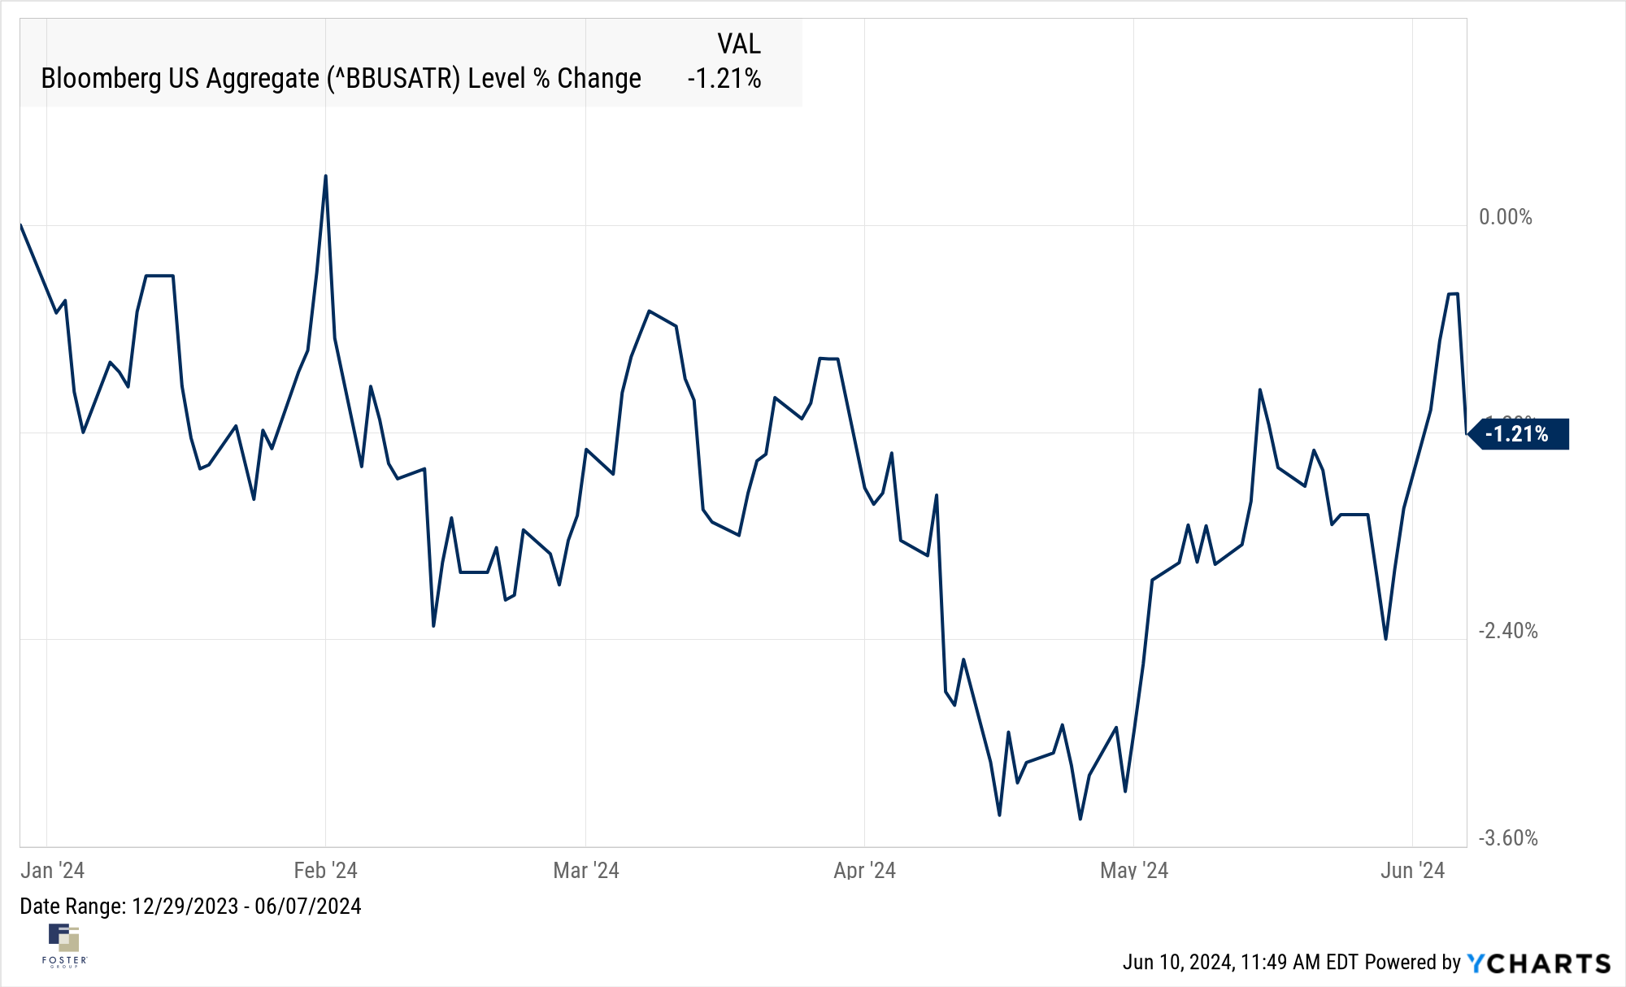
https://www.spine-health.com/treatment/spinal-fusion/multilevel-spinal-fusion-low-back-pain

Slide 4
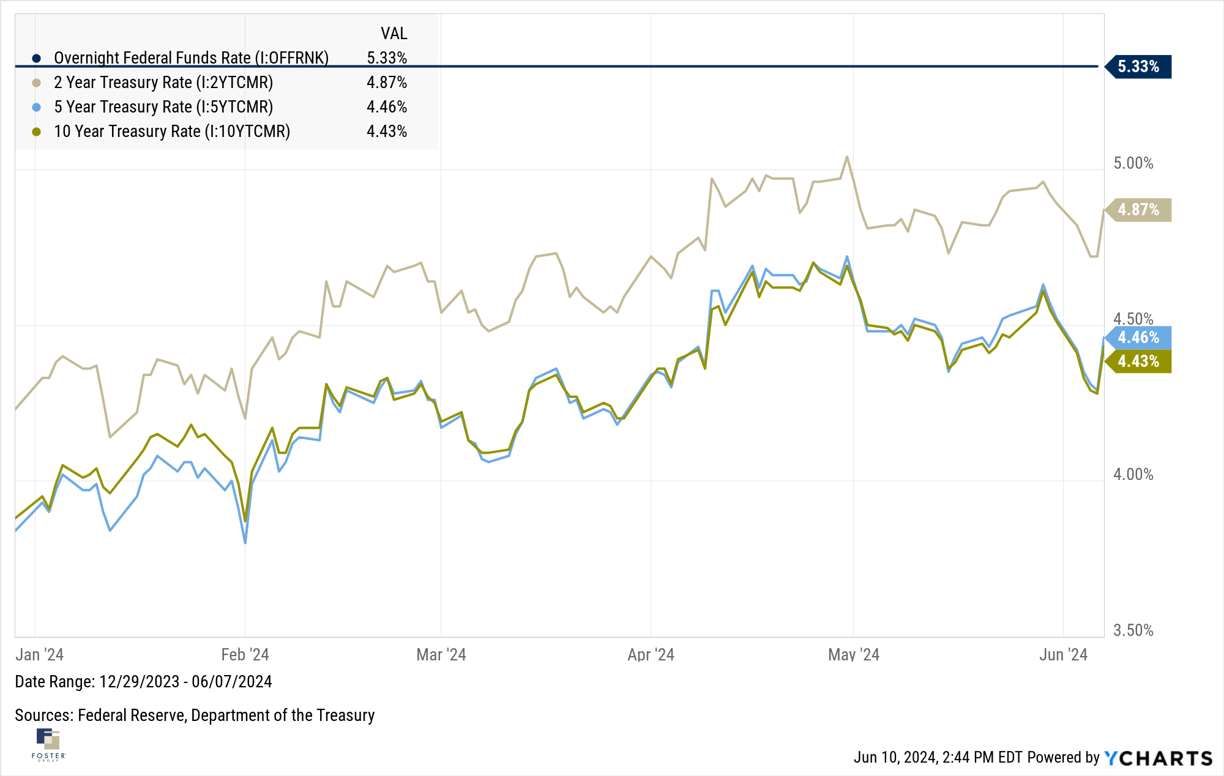
https://www.spine-health.com/treatment/spinal-fusion/multilevel-spinal-fusion-low-back-pain

Slide 5
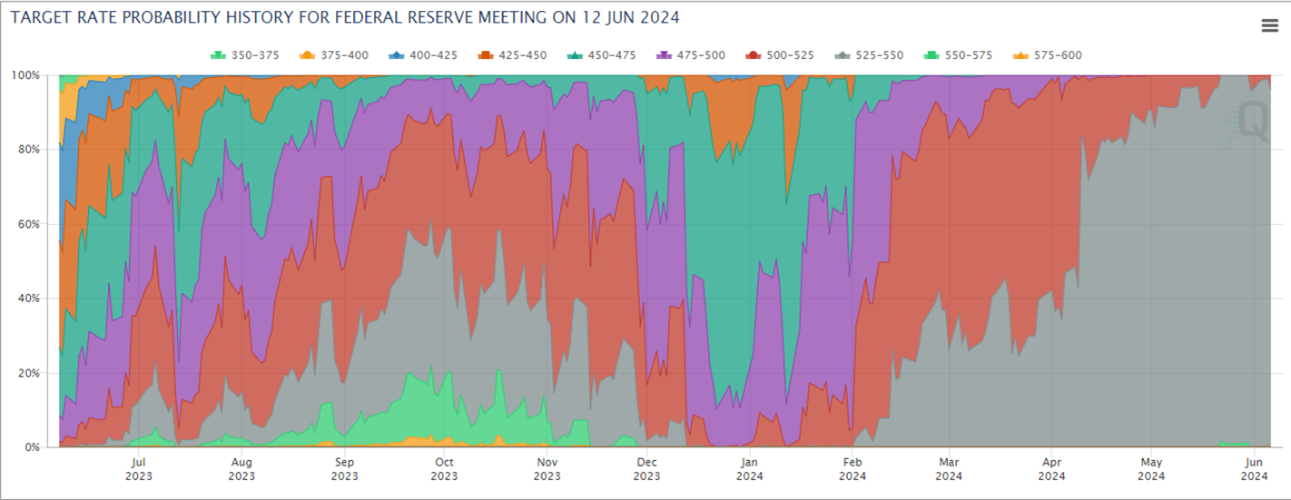
Source: CME FedWatch Tool
Notes:
There is an FOMC meeting on Wednesday where there is currently a 99.4% probability that rates will be unchanged (525-550bps)
On 12/31/2023, the probabilities for Fed Funds rates as of the 6/12/24 meeting:
525-550: 0% probability
500-525: 0% probability
475-500: 10.51% probability
450-475: 67.79% probability
425-450: 20.23% probability
400-425: 1.45% probability
1Y Treasury rates are up about 40bps YTD
2Y, 3Y, 5Y, 7Y, 10Y rates are all up approximately 65bps YTD

Slide 6
 |  | 2 Year US Treasury Note |  | 10 Year US Treasury Bond
Rate 12/31/2023 |  | 4.23% |  | 3.88%
Yield over 6 months |  | 2.12% |  | 1.94%
Income received on $10,000 |  | $211.50 |  | $194.00
Estimated current duration |  | 1.5 |  | 9.5
Market rate change |  | 0.60% |  | 0.60%
Estimated price change from 12/31/23 to 6/30/2024 |  | -0.90% |  | -5.70%
Proceeds from sale |  | $9,910.00 |  | $9,430.00
Total return if you sell on June 30 |  | 1.22% |  | -3.76%
Note: These are hypothetical examples to simulate current conditions

Slide 7
 |  | 2 Year US Treasury Note |  | 10 Year US Treasury Bond
Rate 12/31/2023 |  | 4.23% |  | 3.88%
Yield over total term |  | 4.23% |  | 3.88%
Income per year on $10,000 |  | $423 |  | $388
Duration at maturity |  | 0 |  | 0
Market rate change (your guess) |  | -0.60% |  | 0.00%
Price change from 12/31/23 at maturity |  | 0.00% |  | 0.00%
Income over total term |  | $846 |  | $3,880
Return of principal |  | $10,000 |  | $10,000
Annualized return |  | 4.23% |  | 3.88%
Note: These are hypothetical examples to simulate current conditions

Slide 8
“
Repeat after me: No one—not even the Fed!—can reliably forecast interest rates or the Fed’s actions.
Jason Zweig

Slide 9
Thank you for watching!
Have comments or questions for the team at Foster Group?
Email us at Perspectives@fostergrp.com
Want to learn more about our firm?
Check out our website at fostergrp.com/perspectives
Want to request a meeting with an advisor?
Visit our website at fostergrp.com/requestmeeting
Notes:
There’s a lot of noise out there trying to get your attention. Elections, inflation, markets all provide source material for the promotion of fear and worry. But investors who advance with science are choosing “Educated optimism as an antidote for anxious uncertainty”. Educated optimism can be of great help enabling investors to embrace the uncertainty that is with us all the time.
Our goal is for these podcasts to contribute to you becoming educated and prepared optimists. If there are topics or questions, you’d like us to address please let us know at our website www.fostergrp.com and click on the words Financial Perspectives. And if you are listening to this as a podcast, you can help us spread the message of educated optimism by liking us on your podcast app.
As always thanks for investing some of your time and attention with us!

Slide 10
IMPORTANT DISCLOSURE INFORMATION
Past performance may not be indicative of future results. Different types of investments involve varying degrees of risk. Therefore, it should not be assumed that future performance of any specific investment or investment strategy (including the investments and/or investment strategies recommended and/or undertaken by The Foster Group (“Foster Group”), or any non-investment related content, will be profitable, equal any corresponding indicated historical performance level(s), be suitable for your portfolio or individual situation, or prove successful. Foster Group is neither a law firm, nor a certified public accounting firm, and no portion of its services should be construed as legal or accounting advice. Moreover, you should not assume that any discussion or information contained in this presentation serves as the receipt of, or as a substitute for, personalized investment advice from Foster Group. Please remember that it remains your responsibility to advise Foster Group, in writing, if there are any changes in your personal/financial situation or investment objectives for the purpose of reviewing/evaluating/revising our previous recommendations and/or services, or if you would like to impose, add, or to modify any reasonable restrictions to our investment advisory services. A copy of our current written disclosure Brochure discussing our advisory services and fees is available upon request. The scope of the services to be provided depends upon the needs of the client and the terms of the engagement.
Historical performance results for investment indices, benchmarks, and/or categories have been provided for general informational/comparison purposes only, and generally do not reflect the deduction of transaction and/or custodial charges, the deduction of an investment management fee, nor the impact of taxes, the incurrence of which would have the effect of decreasing historical performance results. It should not be assumed that your Foster Group account holdings correspond directly to any comparative indices or categories. Please Also Note: (1) performance results do not reflect the impact of taxes; (2) comparative benchmarks/indices may be more or less volatile than your Foster Group accounts; and, (3) a description of each comparative benchmark/index is available upon request.

